Slide 1

The Reviver A web based application for finding doctors in critical situations
Proposed by:
Saurov Chandra Biswas
Roll: 16CSE018
Dept. of Computer Science & Engineering
Supervised by:
Md. Samsuddoha
Assistant Professor
Dept. of Computer Science & Engineering
University of Barishal

Slide 2
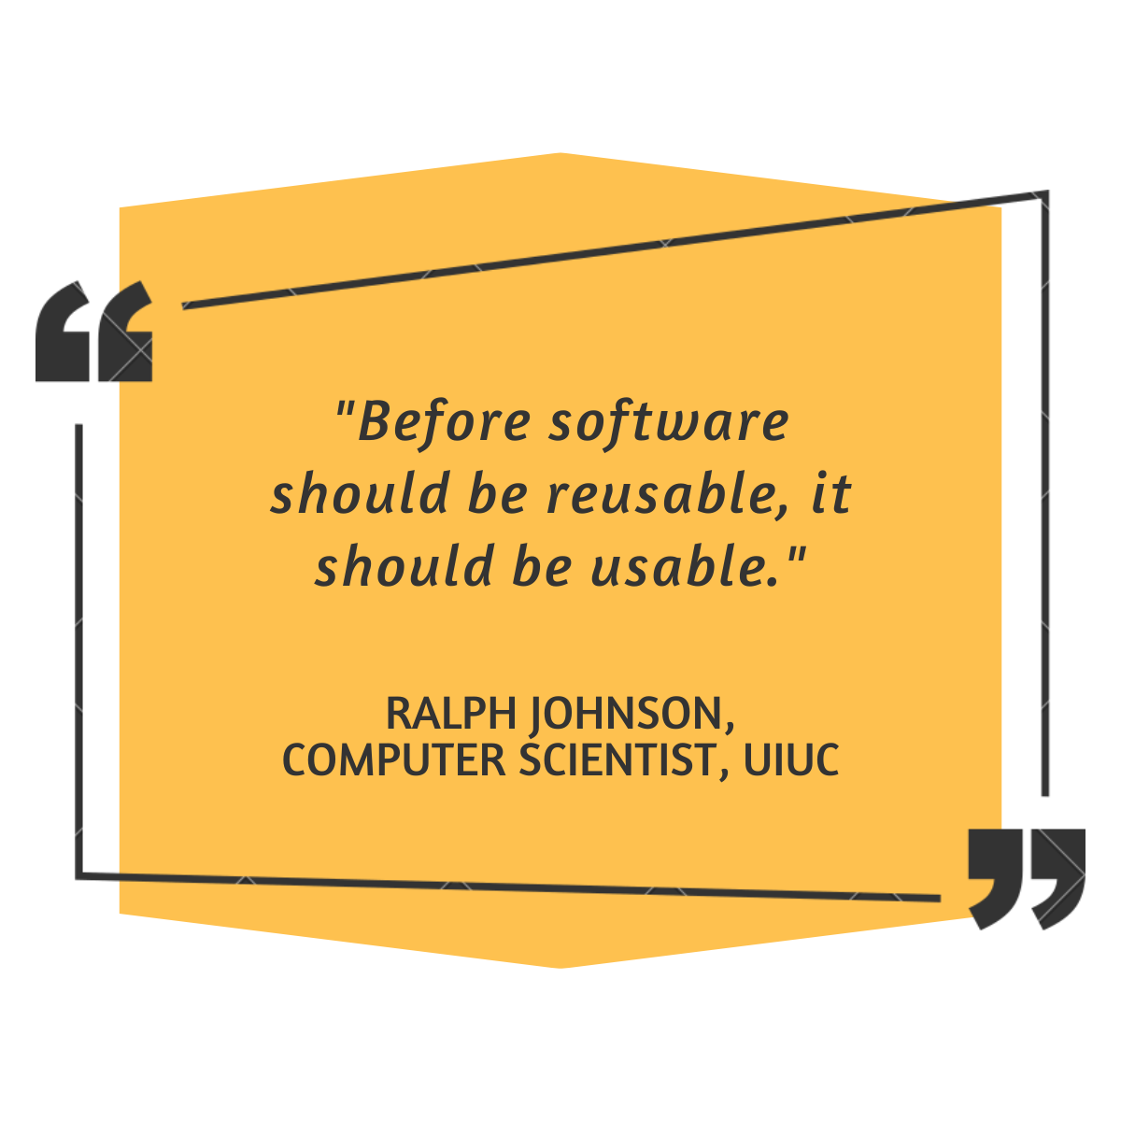
Contents
Overview
Problem statement
Objectives
Motivation
Existing Works
Findings
Features
Implementation Plan & Timeline
Required Technology
Challenges
Limitations
Future work Scope
Q & A?

Slide 3
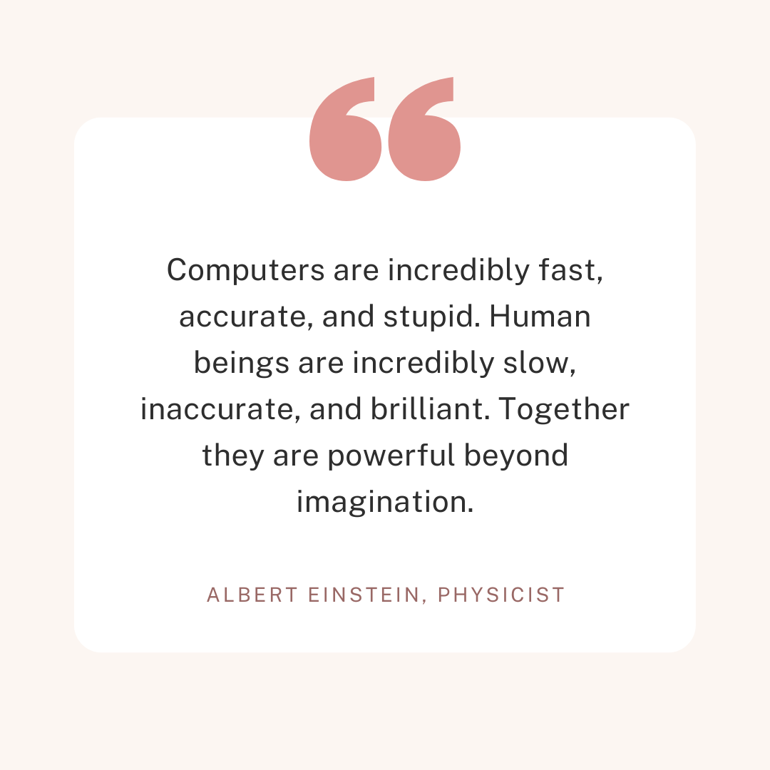
Overview
Web-based application.
Finds available doctors in a critical situation.
Emergency online consultancy.
Doctors and Patients can communicate.

Slide 4
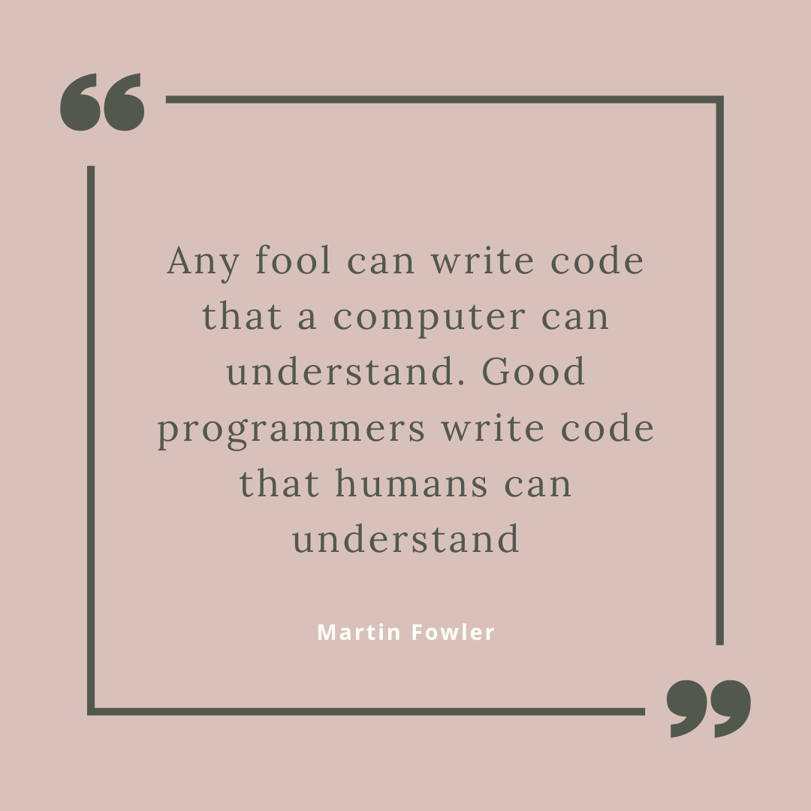
Problem Statement
Where to find a doctor if you fall in an emergency?
What to do if you need an emergency consultation with a doctor?
Our medical & private consultation system is broken and messy. We all know it.
What if you need medical care at midnight?

Slide 5

Objectives
Able to find doctors mostly when doctors are not available.
Pandemic
Late Night
Vacation
Able to find and consult with a doctor in an emergency.
To save the precious lives of people who die unnecessarily for not getting support in time.

Slide 6

Motivation
Pandemic
Aid not received in time.
No proper consultancy was possible because of social distancing.
Who knows if this situation won’t appear again?
A stranded and aid-seeking patient at late night.
First Aid information could be shared.
The time gap for getting emergency care.

Slide 7
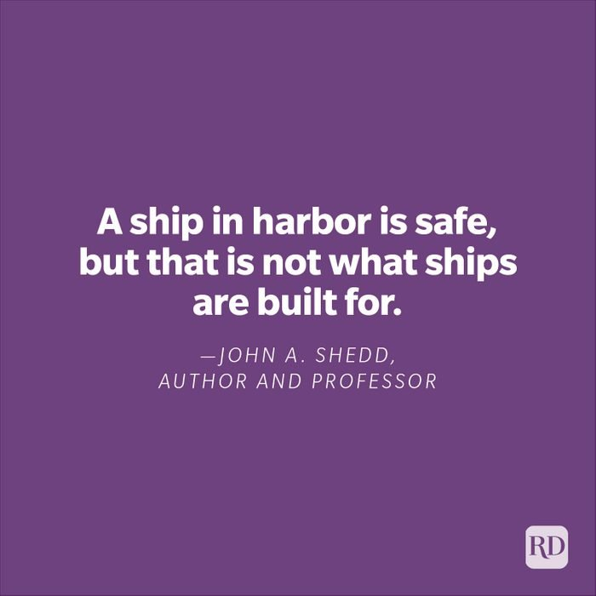
Existing Works
DocTime[1]
Search your Doctor.
Consult live on Video Call.
Instant Prescription.
Verified doctors.
Easy payment options.
Sebaghar[2]
video consultation.
Reputed doctors.
Contact within 1-2 hours.

Slide 8

Findings
None of the available systems provides -
Late Night consultation.
Emergency consultation.
Emergency First Aid consultation.
Find available doctors for emergency response.

Slide 9

Features
Search available doctors for emergency response.
Search available doctors for the late-night consultation.
Search available doctors who provide a free consultation.
Book home consultation.
Contact the doctor for consultation.
Search available doctors of a region.
Take an appointment with a doctor.
View feedback and provide a review to the doctors.
First aid query.

Slide 10
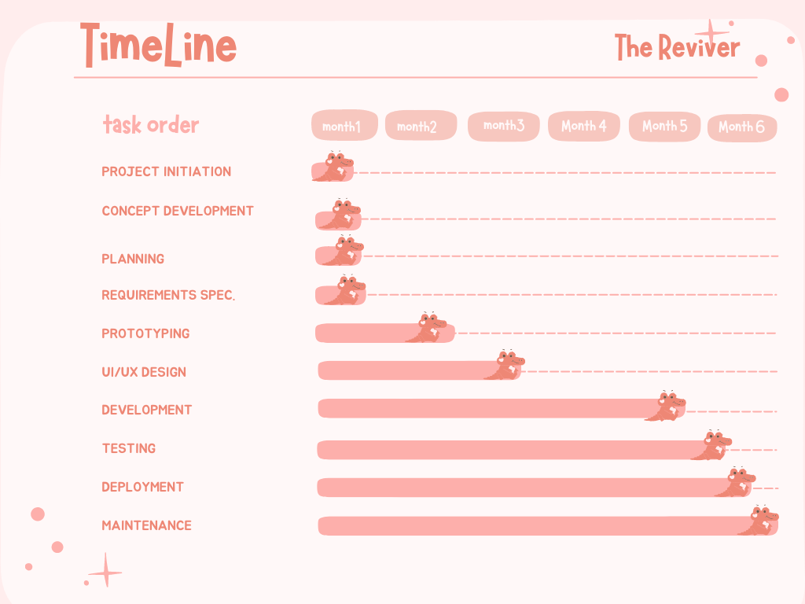

Implementation Plan & Timeline

Slide 11

Required technology
Front End
HTML5, CSS3, BOOTSTRAP4.0
Back End
Python, Django
Database
PostgreSql/MySQL/SQLite
Editor
VS Code

Slide 12

Challenges
To build an Online consultation system.
Marketing of the website.
Verification of Doctors and patients.
Verifying contact requests.

Slide 13

Limitations
Manual checking for quack and spammers.
No budget.
Time Constraints.
Available only for a web-based application.

Slide 14

Future Work Scope
Add Remote Ambulance Finder to the existing system.
Enhance online consultation features.
Verification of Doctors and patients.
Verifying contact requests.
Integrate with the mobile-based application.

Slide 15

Conclusion
Life is precious.
If a we could have the chance to save a person, we should grab that chance.
Finding doctors in an emergency is a relief from stress.

Slide 16
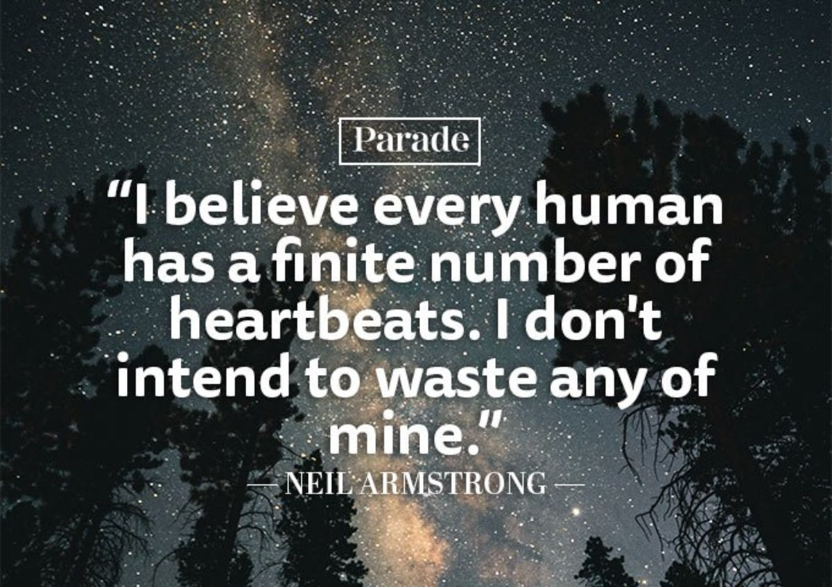
References
[1] . [Online]. Available: https://doctime.com.bd/ (visited on 05/06/2022)
[2] . [Online]. Available: https://sebaghar.com/ (visited on 05/06/2022)

Slide 17


Slide 18
